Slide 1
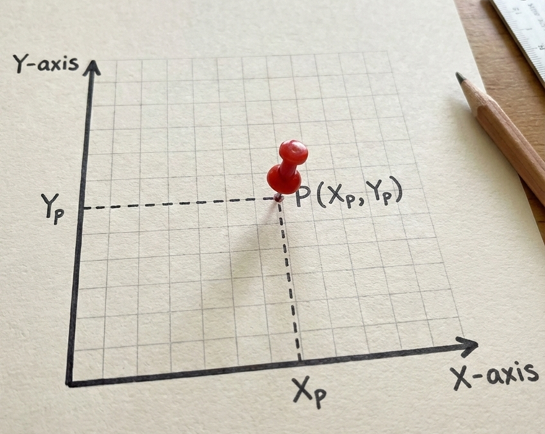
Summary of Lesson
✅Circle
patches.Circle((Xp, Yp), radius=r, facecolor=“colorname")
✅Rectangle
patches.Rectangle((Xp, Yp), width=w, height =h, facecolor=“colorname", angle=degree)
✅ Ellipse (Oval)
patches.Ellipse((Xp, Yp), width=w, height=h, facecolor="colorname“, angle=degree )
✅ Regular Polygon
patches.RegularPolygon((Xp, Yp), numVertices=n, radius=r, facecolor="colorname“, angle =degree )

Slide 2
Single for loop
for i in range(start, stop, step):
instruction_1
instruction_2
Important Notes:
Indentation matters: All instructions inside the loop must be indented.
Ending the loop: Stop indenting to exit the loop. The next line aligned to the left is outside the loop.
range(start, stop, step) generates numbers (integer) from start to stop, incrementing by step.

Slide 3
Example of Single for loop
for i in range(2, 11, 2):
print(i)
Output
2
4
6
8
10

Slide 4
Nested for loops
for i in range(start-1, stop-1, step-1):
instruction_1
instruction_2
for j in range (start-2, stop-2, step-2):
instruction_2
instruction_2
Important Notes:
Indentation matters: All instructions inside the loop must be indented.
Ending the loop: Stop indenting to exit the loop. The next line aligned to the left is outside the loop.
range(start, stop, step) generates numbers (integer) from start to stop, incrementing by step.
-

Slide 5
Example of Nested for loops
for i in range(1, 4,1):
print(i)
for j in range (8, 6, -1):
print(j)
Output
1
8
7
2
8
7
3
8
7
-
-

Slide 6
Nested for loops vs Sequential for loops
for i in range(start-1, stop-1, step-1):
instruction_1
instruction_2
for j in range (start-2, stop-2, step-2):
instruction_2
instruction_2
for i in range(start-1, stop-1, step-1):
instruction_1
instruction_2
for j in range (start-2, stop-2, step-2):
instruction_2
instruction_2
Nested for loops runs one loop inside another loop. Inner loop repeats every time the outer loop runs once.
Sequential for loops run one after another.

Slide 7
If Condition
if condition:
instruction_1
instruction_2
Important Notes:
The condition is an expression that evaluates to True or False.
The colon : is required
The indented block runs only if the condition is True
Conditions use comparison operators:>, <, >=, <=, ==, !=
-

Slide 8
Example
Output:
10
Output:
x = 10
if x > 5 :
print(x)
x = 10
if x < 5 :
print(x)
-
-

Slide 9
If-else Condition
if condition:
instruction_1
else:
instruction_2
Important Notes:
If the condition is False, the else block runs
-
-

Slide 10
Example
Output:
x is less than 5
x = 4
if x > 5 :
print(“x is greater than 5”)
else
print(“x is less than 5”)
-
-

Slide 11
If-elif-else Condition
if condition1 :
instruction_1
elif consition2:
instruction_2
else:
instruction_3
Important Notes:
If the if condition is False, Python checks the elif condition.
If the elif condition is also False, the else block executes.
-
-
-

Slide 12
Example
Output:
Grade: B
score = 85
if score >= 90 :
print(“Grade: A”)
elif score >= 80:
print(“Grade: B”)
else:
print(“Grade: C”)
-
-
-

Slide 13
While loop
while condition:
Instruction
-

Slide 14
Example
Output:
0
2
4
6
8
i = 0
if i <10 :
print(i)
i=i+2
-

Slide 15

Access Computer
💻 Login to the Computer
Username: .\guest Password: Carbondale!
🚀 Launching Python Jupyter Notebook
Click the Jupyter icon in the bottom menu to
launch Jupyter Notebook.
Once it opens, you are ready to begin coding!

